Slide 1
MGT 153 Presentation
Group 6

Slide 2
Evaluation of Industry Trend
KPI: Sales/Population
Focus on Japan and North America markets
Focus on Puzzle and Role-Playing Genre
3 KPI Created
Japan Sales/Pop
NA Sales/Pop
Difference between Japan and NA KPI (Japan-NA Sales/Pop)

Slide 3
Evaluation of Industry Trend
James Spier’s Approach
Japan market > US market
Role-Playing > Puzzle
3 AB Testing
JP Sale/Pop- Puzzle (v1) vs Role-Playing (v2)
NA Sale/Pop- Puzzle (v1) vs Role-Playing (v2)
Diff JP - NA Sale/Pop- Puzzle (v1) vs Role-playing (v2)

Slide 4
Evaluation of Industry Trend
AB Testing 1 JP Sale/Pop- Puzzle (v1) vs Role-Playing (v2)
Diff. 7.59E-4
P Value: 0.15%
AB Testing 2 NA Sale/Pop- Puzzle (v1) vs Role-Playing (v2)
Diff. 2.29E-4
P Value: 0.21%
AB Testing 3 Diff JP - NA Sale/Pop- Puzzle (v1) vs Role-playing (v2)
Diff. 5.3E-4
P Value: 0.89%

Slide 5
Evaluation of Industry Trend
James Spier’s approach reasonable
Japan market scores higher than NA market
Transition from Puzzle to Role-Playing genre is logical

Slide 6
Markets to Target
Use sale # rather than sale/pop
Focus on Role-Playing games
Collect data of average sales from NA, EU, JP and Other
AB Testing
Average of NA sales (v1)
Average of EU sales (v2)
Average of JP sales (v3)
Average of Other (v4)

Slide 7
AB Test Result
V2 vs V1
Diff. -148856.21
P Value: 100%
V3 vs V1
Diff. -152173.2
P Value: 100%
V4 vs V1
Diff. -262336.6
P value: 100%

Slide 8
Markets to Target
AB Test Result Inconclusive regarding Role-Playing genre
No evidence to shift focus from v1 (NA) to other variants

Slide 9
Changing Preference & Demographic
Identifying trends of highest performing genre of games in NA
HIerarchical Clustering
Clustering based off Critic Score, Critic Count, User Score, User Count
Split into 9 clusters
Comparison & Select highest performing cluster regarding NA KPI
Identifying highest frequencies within cluster

Slide 10
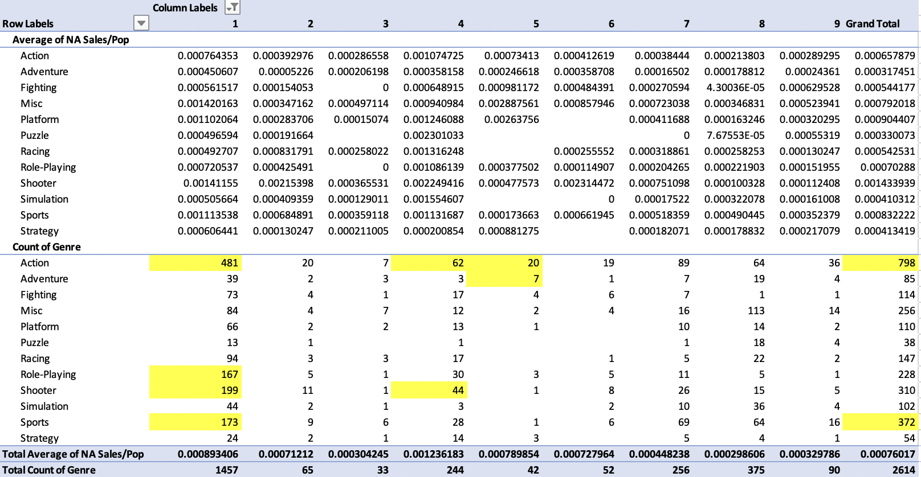
Hierarchical Clustering Result

Slide 11
Changing Preference & Demographic
Top performing cluster 4, 1, 5
Cluster 4: Action, Shooter
Cluster 1: Action, Role-Playing, Shooter
Cluster 5: Action, Adventure
Cluster 1: Sport
Consumer preference shift toward action, role-playing, shooter, adventure genre
Sports genre inconclusive, need more info
ER Games can consider branching into these genres in the future

